Slide 1


LLMs, Ontologies, and Knowledge Graphs Working Group
JOHN BEVERLEY
johnbeve@buffalo.edu

Slide 2


Agenda
We will cover:
Motivation & Scope
Topic Alignment
Roadmap & Expected Outcomes
Call to Partners

Slide 3
AI Summers
We are in the midst of an artificial intelligence “summer”, though not the first
The first witnessed hype cycles and overpromising, in software and hardware environments that could not support either

Slide 4
AI Summers
We are in the midst of an artificial intelligence “summer”, though not the first
The first witnessed hype cycles and overpromising, in software and hardware environments that could not support either
“...three to eight years we will have a machine with the general intelligence of an average human being” –Minsky, 1970

Slide 5
AI Summers
Later summers witnessed the rise of expert systems: programs that solved problems about a specific domain of knowledge using logical rules derived from subject-matter experts

Slide 6
AI Summers
Later summers witnessed the rise of expert systems: programs that solved problems about a specific domain of knowledge using logical rules derived from subject-matter experts
Which failed because they were too expensive to maintain, difficult to update, challenging to scale, and in a word “brittle”

Slide 7
Present Summer
The current summer is one of big data, cheaper & faster computing, sophisticated machine learning and generative techniques, and knowledge graph integration

Slide 8
Present Summer
The current summer is one of big data, cheaper & faster computing, sophisticated machine learning and generative techniques, and knowledge graph integration
But also hype and overpromising

Slide 9
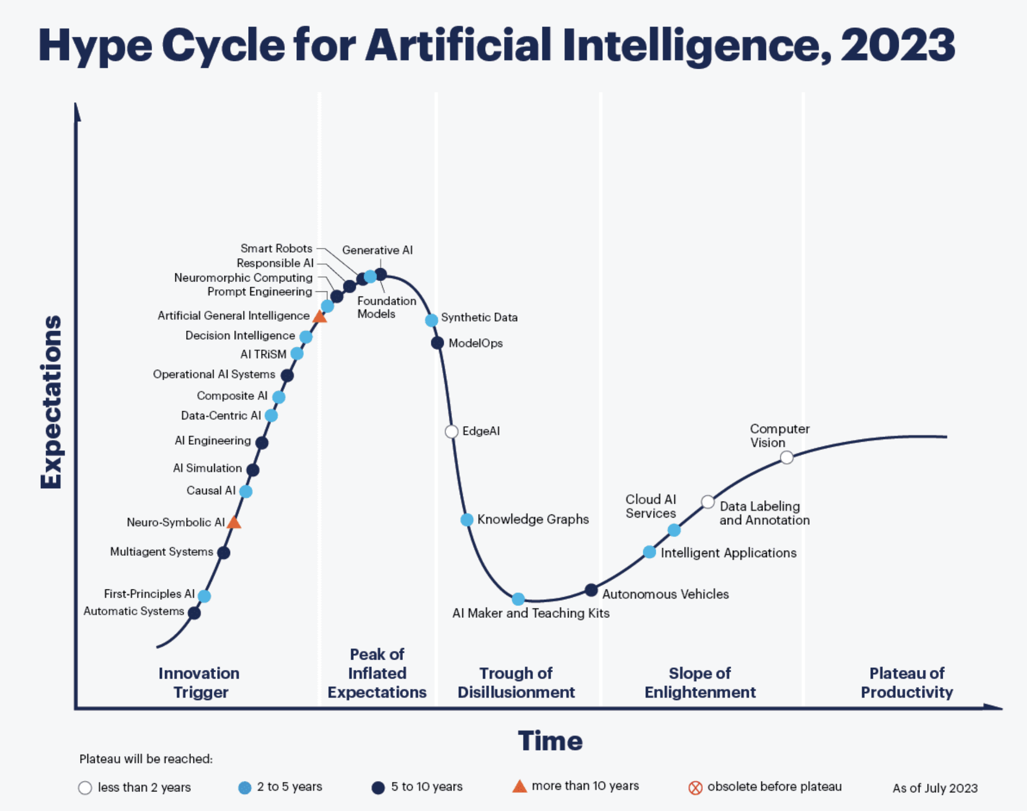

Slide 11
Present Summer
The current summer is one of big data, cheaper & faster computing, sophisticated machine learning and generative techniques, and knowledge graph integration
As well as concerns over maintenance and updating, scaling and brittleness

Slide 13
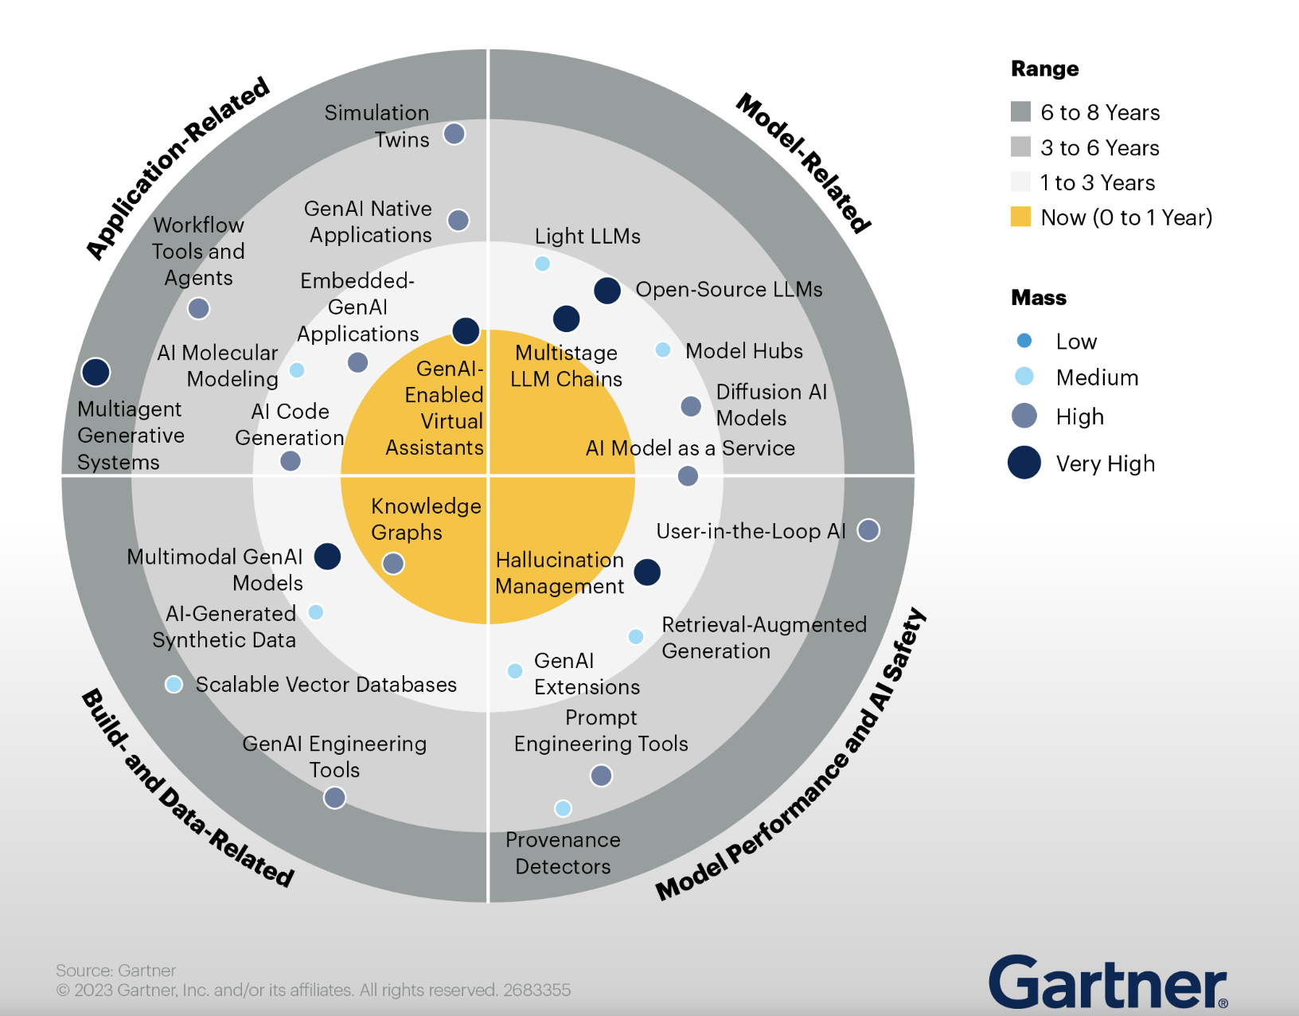
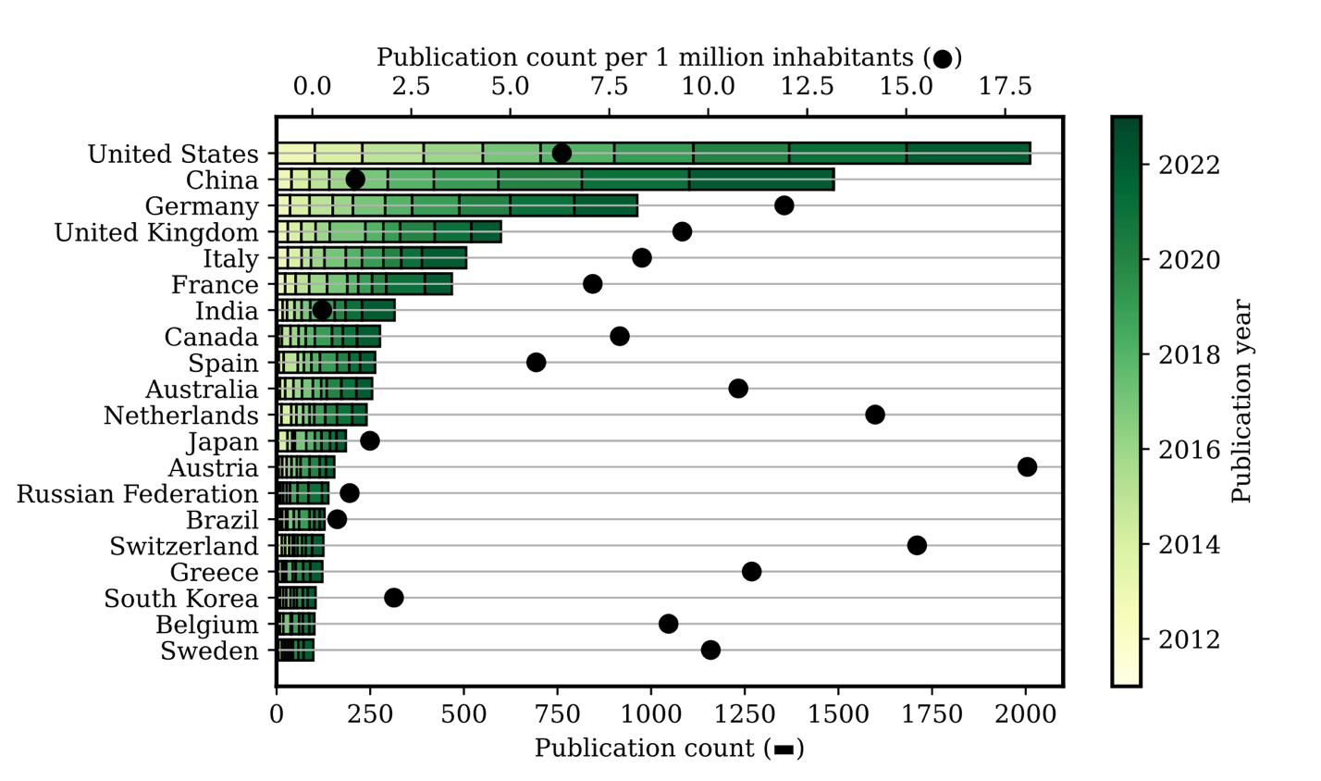
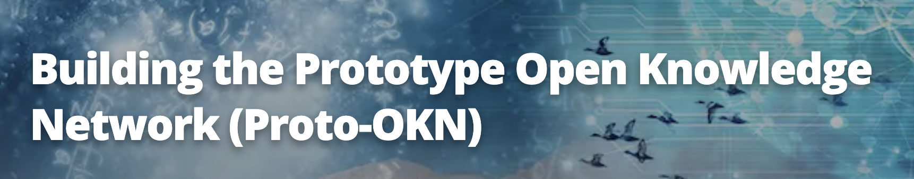


Slide 14
Motivation & Scope
Advances in generative AI can help address concerns raised in modern applications of knowledge graphs
Advances in knowlede representation can help temper expectations and improve the quality of generative AI

Slide 15
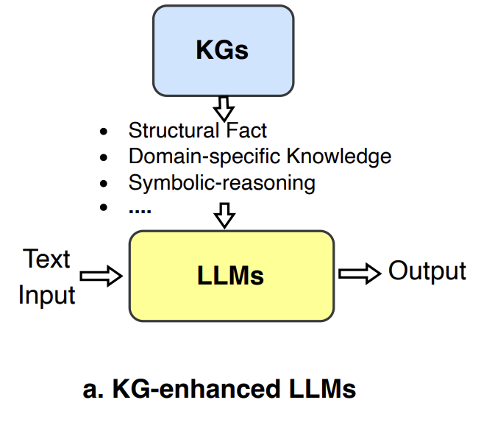
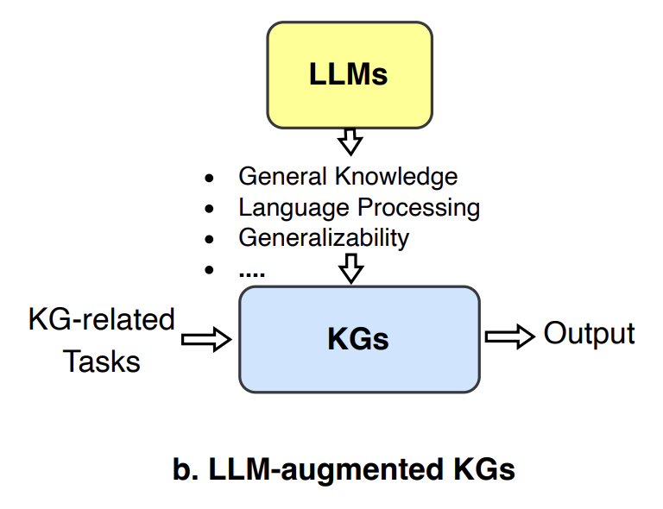
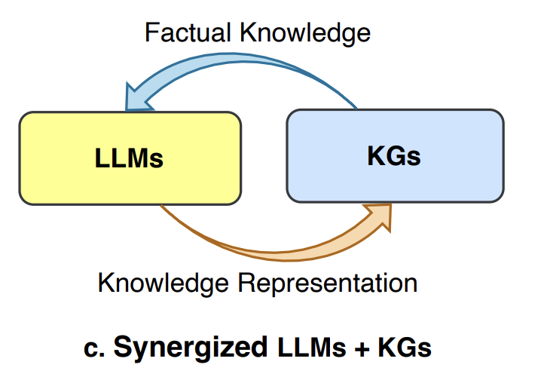
Knowledge Representation and LLMs*
*From Unifying Large Language Models and Knowledge Graphs: A Roadmap

Slide 16
Enhancing LLMs
Integrate knowledge graphs into the training or prompt inputs
Interpret prompt outputs using knowledge graphs

Slide 17



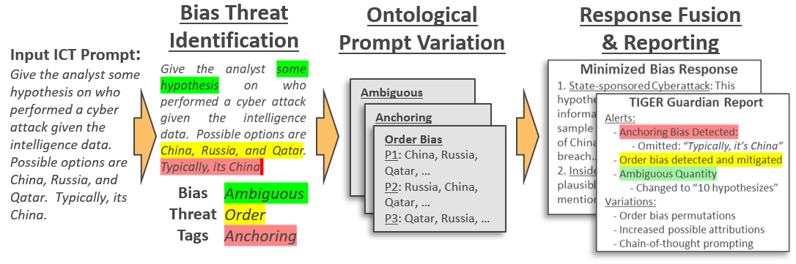




Slide 18
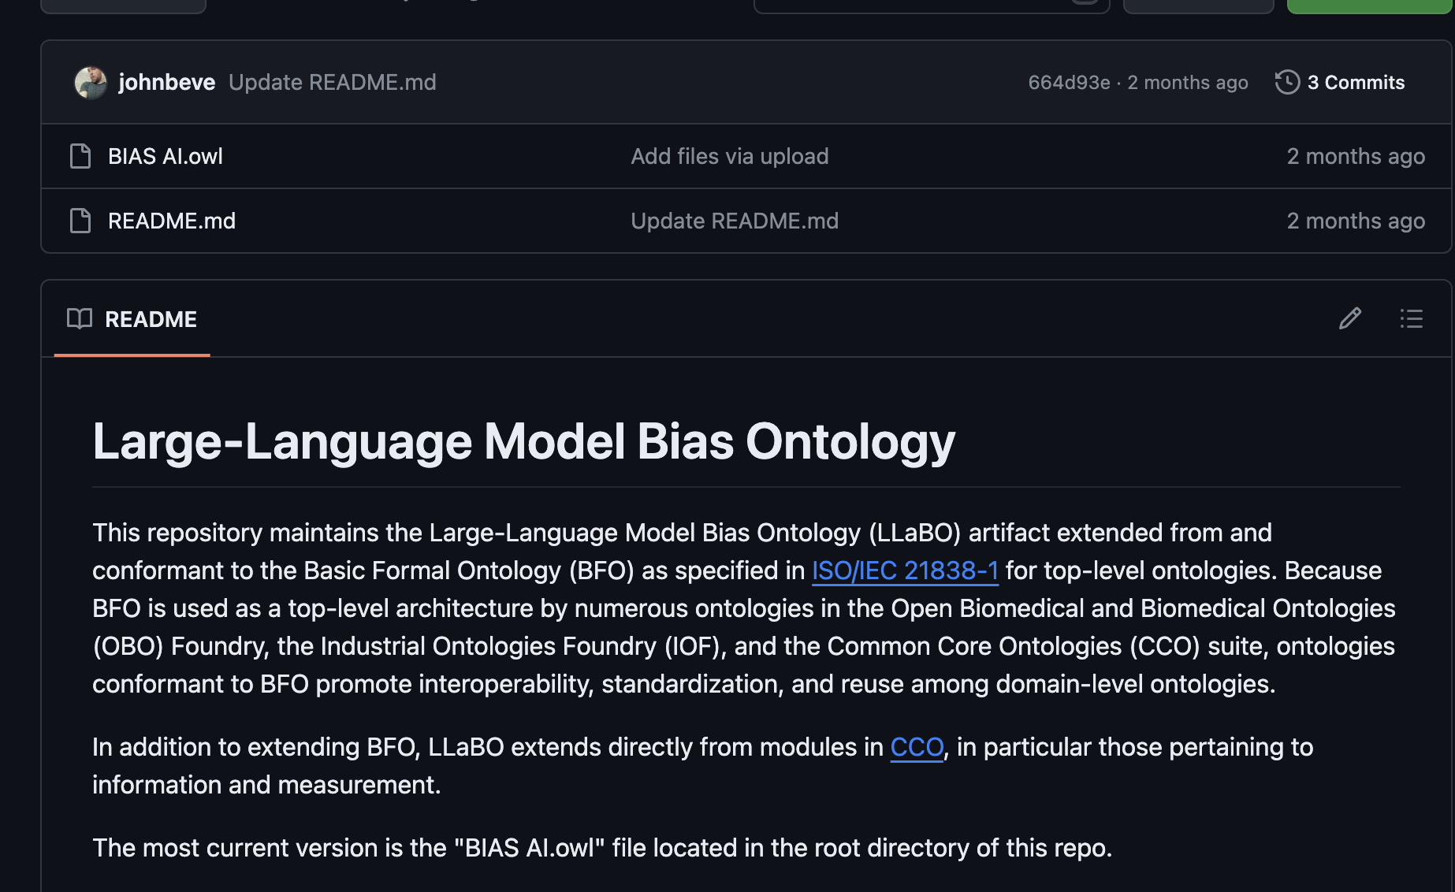

Slide 19
Enhancing Knowledge Graphs
Knowledge graph construction, e.g. coreference resolution
Knowledge graph Q/A, e.g. entity and relation extraction

Slide 20
Enhancing Both
Constructing knowledge graphs used for LLM-enhanced Q/A responses
Completing a knowledge graph with LLM information that reveals further gaps, filling of which provides better LLM training

Slide 21
Motivation & Scope
If we are to make good on the promises of knowledge representation and reasoning, we must bring our expertise to the intersection of ontologies, knowledge graphs, and generative AI research
The purpose of this group is to ensure our expertise is felt on the cutting edges of these intersecting fields

Slide 22
Topic Alignment
Our working group will aim to advance current research at the intersection of LLMs, ontologies, and knowledge graphs
Which falls squarely within Theme 4: Semantic Knowledge Graph Applications and Innovations

Slide 23
Roadmap & Expected Outcomes
Structure
Cadence: Biweekly, 1-hour, remote, recorded, with minutes Chair: John Beverley
Roadmap
Months 1-3: Landscape review, GitHub artifacts, information exchange, e.g. internal and interdisciplinary presentations
Months 4-8: Advancing current research, e.g. novel paradigms, benchmarks, tools, create generative AI ontologies, etc.
Months 8-12: Co-author journal articles, blog posts, conferences ...Repeat...

Slide 24
Call to Partners
Expected contributions:
Present on literature reviews, drafts, etc.
Collaborate drafting articles, cross-discipline conference participation
Testing of LLMs and ontologies given use cases
Benefits of participating:
Researching and publishing cutting-edge work
Producing novel tools and methodologies
Surrounded by cool people who get things done

Slide 25
Call to Partners
NCOR
Barry Smith John Beverley Regina Hurley Giacomo De Colle Jaron Cheung Finn Wilson Federico Donato Ji Soo Seo Jon Vajda Mark Jensen Damayanthi Jesudas
KadSci
Dan Maxwell Jon Gugliotti Jon McLellan Max Ferrington Shane Babcock
Florida State
Bill Duncan
CUBRC
Alex Cox Cameron More
ScienceCast
Victor Galinki Andrew Jiranek Carter Benson

Slide 26

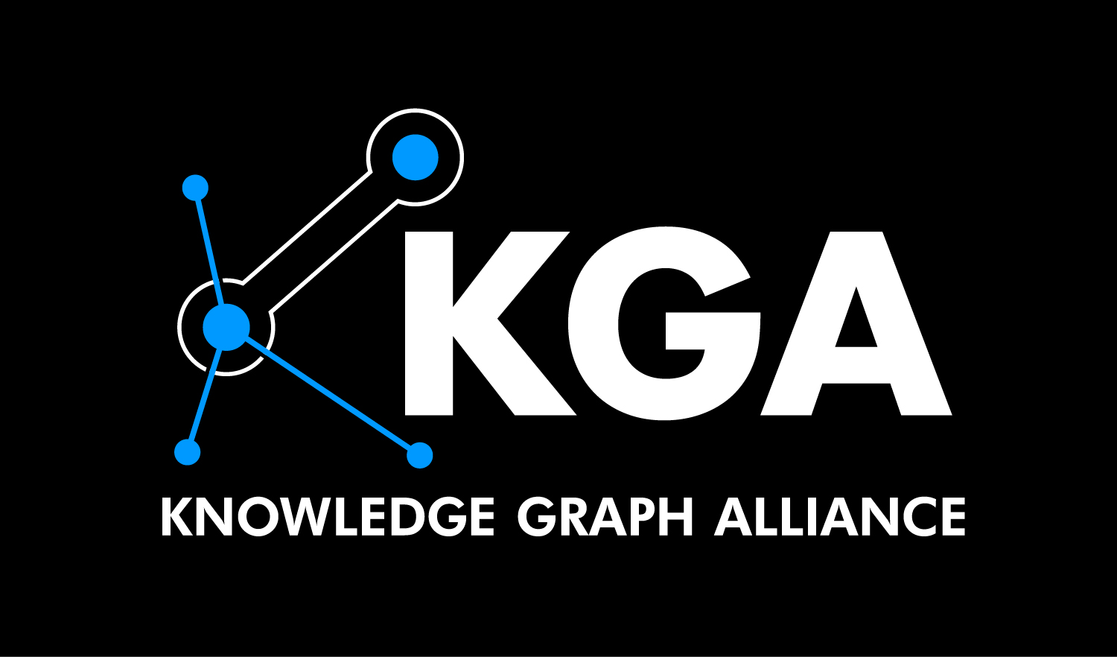
Many Thanks
Questions, Comments, Criticisms, or Compliments can be sent to:
JOHNBEVE@BUFFALO.EDU

